Slide 1
Safe Operations Factors

Slide 2
Aeronautical Decision Making

Slide 3
Aeronautical Decision Making
A systematic approach to making the best possible decisions when flying
80% of aircraft accidents are due to pilot error
Accidents rarely occur due to a single issue. In most cases, there is some sort of chain of poor decisions that cause the accident.

Slide 4
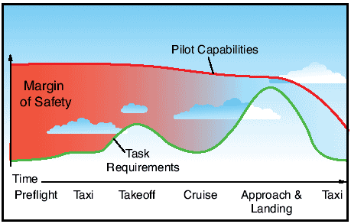
Task Management
Aviate
Navigate
Communicate

Slide 5
Crew Resource Management (CRM)
CRM is the effective use of all resources available to the crew
Do all crew members know their job and how to do it effectively?
Do all crew members know how to use all of the resources available to them?

Slide 6
Hazardous Attitudes
Hazardous Attitude | Symptoms | Response
Anti Authority | Don’t tell me what to do | Follow the rules. They are usually right.
Impulsivity | Do something! Quick! | Not so fast. Think first.
Invulnerability | It can’t happen to me | It can happen to me.
Macho | I’ve got this | Taking risks is foolish
Resignation | What’s the point? | I can do something

Slide 7
Emergency Operations

Slide 8
Lost Link
A disconnect between the sUA and the control system
Some sUAS will automatically initiate a return to home function

Slide 9
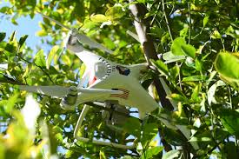
Controlled Flight Into Terrain (CFIT)
The best thing to do is to avoid CFIT
Be aware of your surroundings
Never rely on the obstacle sensors on the sUA

Slide 10
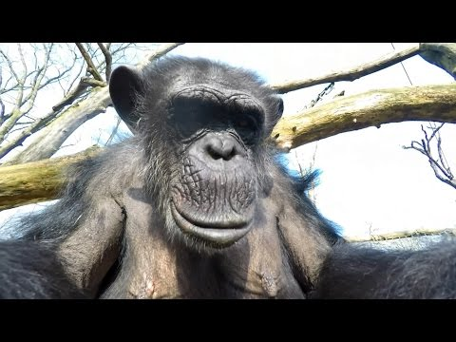

Slide 11
Loss of GPS
Part of your preflight should be looking for GPS NOTAMS
Fly the aircraft
Practice flying in “Atti Mode”

Slide 12
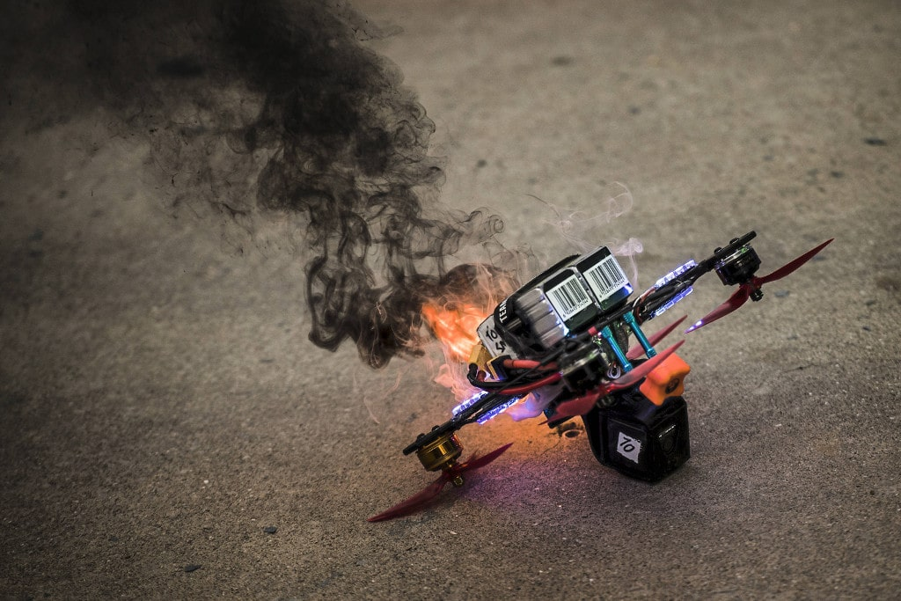
Battery Fire/Thermal Runaway
Find a safe place to land and land ASAP
Extinguish the fire by any means necessary

Slide 13
Fly Away
Try to re establish connection
Advise ATC if in or near controlled airspace
The sUA should return to home automatically

Slide 14
Emergency Flight Termination
If it is determined that you will not be able to fully re-establish control of the sUA, find the area that is least likely to cause significant damage

Slide 15
Aeromedical Factors

Slide 16
Dehydration and Heat Stroke
Causes
Hot and/or dry air, wind, diuretic drinks including coffee, tea, alcohol, and pop, diarrhea, vomiting, perspiration, excessive urination
Symptoms
Headache, fatigue, cramps, sleepiness, dizziness, weakness, nausea, tingling hands and feet, and thirst (if you are thirsty, you are already dehydrated to the point of having decreased performance)
Effects
Decreased performance
Corrective Actions
Drink water and lots of it
If you do feel thirsty, drink more than it takes to not feel thirsty
Limit caffeine and alcohol

Slide 17
Drug and Alcohol Use
Causes
Alcohol and drugs, legal and illegal
Symptoms
Fatigue, decreased mental processing, slow motor and reaction responses, hallucinations, impaired judgment, decreased sense of responsibility, diminished memory, reduced reasoning, and reduced attention span
Effects
Decreased mental processing, slow reaction times
Corrective Actions
DO NOT DRINK OR DO DRUGS AND FLY
The legal limit is 8 hours from bottle to throttle
The legal limit is 0.04%, but if there is any noticeable effect, including hangovers, you are still not allowed to fly.
Do not fly while taking medication (including prescription medicine), unless it was approved by the FAA

Slide 18
Hyperventilation
Causes
Too little Co2 in your body as a result of breathing too rapidly or too deeply
Symptoms
Drowsiness, dizziness, shortness of breath, feeling of suffocation, pale, clammy appearance, and muscle spasms.
Effects
Can lead to unconsciousness
Corrective Actions
Consciously slow your breathing, talk out loud, or breath into a paper bag

Slide 19
Stress
Causes
The bodies response to the physical and psychological demands placed on it
Symptoms
Increased heart rate, breathing, sweating, and blood pressure as the body prepares to fight or flee
Effects
Small amounts of stress help you focus, but too much stress interferes with your ability to focus and cope with a situation
Corrective Actions
If experiencing chronic stress, talk to a physician
Avoid flying when stressed or tired

Slide 20
Fatigue
Causes
Inadequate rest, excess physical and mental work, stress, mild hypoxia, noise, and vibrations
Symptoms
Weakness, tiredness, heart palpitations, breathlessness, headaches, irritability, stomach problems, and generalized aches and pain
Effects
Decrease in concentration and attention, impaired coordination, and decreased ability to communicate
Corrective Actions
Get adequate rest on a regular basis prior to the flight. Not treatable during flight

Slide 21
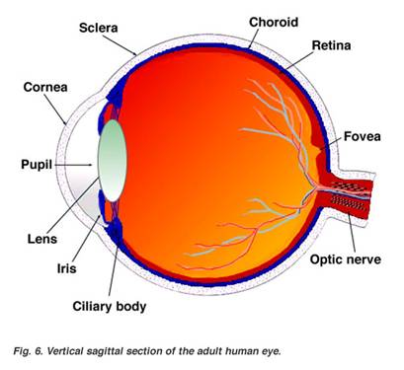
Vision
Anything that affects the pilot’s physical or mental well being can affect their vision or perception (Illness, medication, stress, alcohol, fatigue, emotion, hypoxia, etc)
Eye anatomy
While we have ~200 degrees visible to our eyes, only a space about the size of a postage stamp at arm’s length is actually clear and in focus

Slide 22
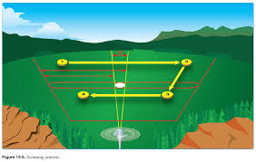
Scan
Use a series of short, regularly spaced eye movements that search each successive area
Each eye movement should not exceed 10 degrees and should last at least 1 second to allow time to detect anything in that area
Lack of color contrast and brightness makes it difficult to locate aircraft during the day

Slide 23
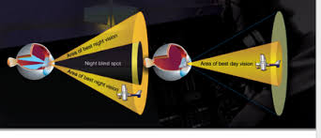
Blind Spot
In the retina, there is a section that has no rods or cones because the optic nerve is connected there
We typically don’t notice this area, but it is possible for things to not be visible if they are in this area of your vision

Slide 24
Empty Field Myopia
Eyes fixate on nothing if there is nothing to focus on
Causes the pilot to look without seeing

Slide 25
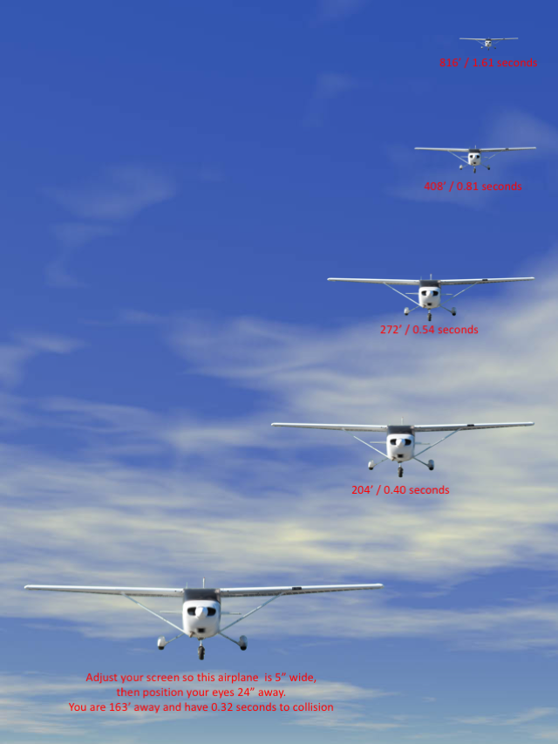

Slide 26
Any Questions?

